Slide 1
Why Do We Program?
Course Code: CSC1102 &1103
Course Title: Introduction to Programming
Dept. of Computer Science
Faculty of Science and Technology
Lecturer No: | 0.0 | Week No: | 1 | Semester: | Summer 2024-2025
Course Instructor: | Md. Mazid-Ul-Haque, Assistant Professor, mazid@aiub.edu

Slide 2
Answer……?
To solve complex problems efficiently.
To automate repetitive tasks and save time.
To build software, apps, and digital tools.
To drive innovation in AI, robotics, and science.
To control and interact with technology.
To express creativity through games, art, and design.
To unlock high-paying career opportunities.
To develop logical and structured thinking skills.
To analyze and visualize data effectively.
To connect people globally via the internet.
To improve efficiency in businesses and industries.
To experiment with new ideas quickly.
To secure systems and protect data.
To customize technology for personal needs.
To prepare for a tech-driven future.
And so on…….

Slide 3
May be to effectively manage data?
Data is the foundation of all computing—code exists to store, retrieve, manipulate, and analyze it.
Even non-data tasks (e.g., robotics, gaming) rely on information flow (sensor data, user inputs, physics calculations).
If you strip away abstractions, nearly all programming ultimately revolves around data—its shape, flow, and meaning.

Slide 4
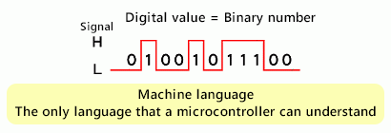
What is a computer?
Computers are electronic devices
Process electrical signals: ON (high voltage) / OFF (low voltage)
Represented as binary digits: 1 and 0

Slide 5
What is machine language?
Set of instructions directly understood by the CPU
Written in binary (0s and 1s)
Fast for machines, but hard for humans to write/read
Small mistakes can cause big errors

Slide 6
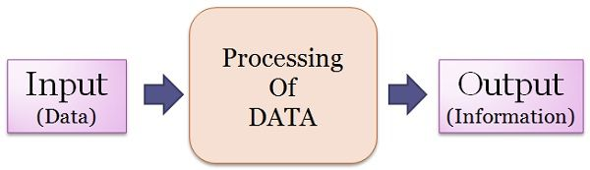
Data vs Information
Data: raw facts and numbers (e.g., 23, 75, “abc”)
Information: processed data with meaning (e.g., “Temperature is 23°C”)
Programming helps transform data into useful information

Slide 7
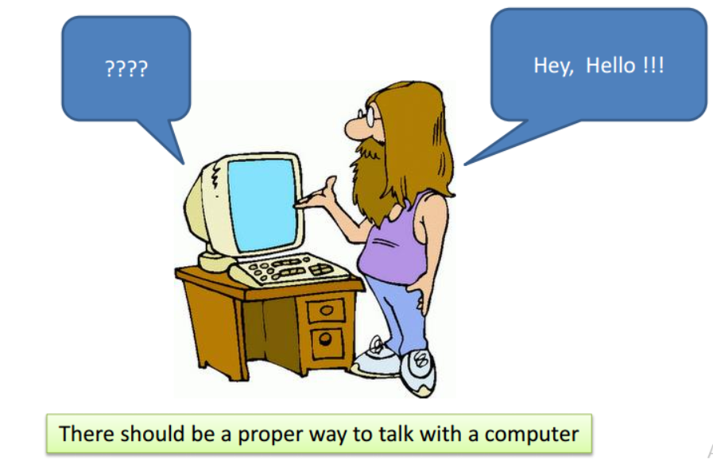
Why not use human language?
Human language: creative, rich, but ambiguous
Same request can be expressed in many ways
Cultural and regional variations add complexity
Computers need precise, universal instructions

Slide 8
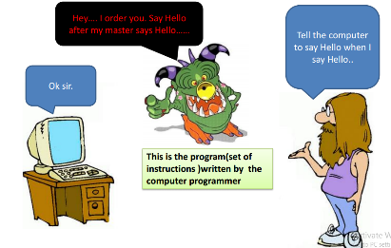
Programming languages: the bridge
Special artificial languages created to communicate with machines
Have syntax (rules) and semantics (meaning)
Universal: same code works anywhere in the world
Easier for humans to learn and use than raw binary

Slide 9
History & evolution of C++
1940s–50s: Machine language
1950s–70s: Assembly & high-level languages like C
1979: Bjarne Stroustrup begins “C with Classes.”
1983: Renamed to C++, adds classes and basic OOP.
1989–1990: Adds multiple inheritance and templates.
1998: C++98 standard with STL.
2003: C++03 minor fixes.
2011: C++11 adds auto, lambdas, move semantics.
2014: C++14 small enhancements.
2017: C++17 adds structured bindings, parallelism.
2020: C++20 brings concepts, ranges, coroutines.
2023–future: C++23 and beyond refine and modernize further.

Slide 10
So again, why do we program?
Solve real-world problems
Automate repetitive tasks
Build apps, games, websites
Learn logical thinking & creativity
Programming transforms ideas into actions a computer can perform

Slide 11
How to learn programming at university?
Structured, step-by-step learning
Teachers explain, correct, and guide
Practice through projects and teamwork
Learn to debug and think critically
Online platforms help, but teachers provide deeper context and feedback

Slide 12
Let’s begin…. Happy learning!

